Slide 1
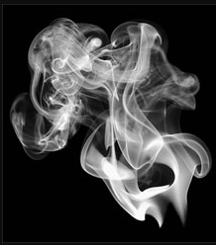
Smoke Test
Automate the Automation and avoid the Repetition
CBSI TEAM

Slide 2
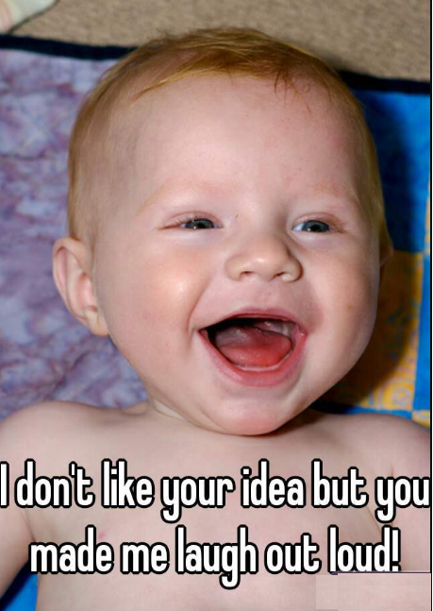
I don’t like your idea but you made me laugh out loud ☺
I need your 10 15 minutes
Yes, if we think its been already implemented, we will think over another IDEA…

Slide 3

Lets have a demo first

Slide 4
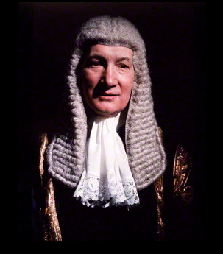
Point to be noted my lord

Slide 5
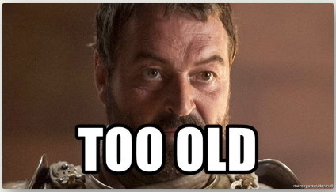
Selenium is too Old? uhh?
I am not talking about the tool or framework or technology, I am talking about the implementing the things in a different way.

Slide 6
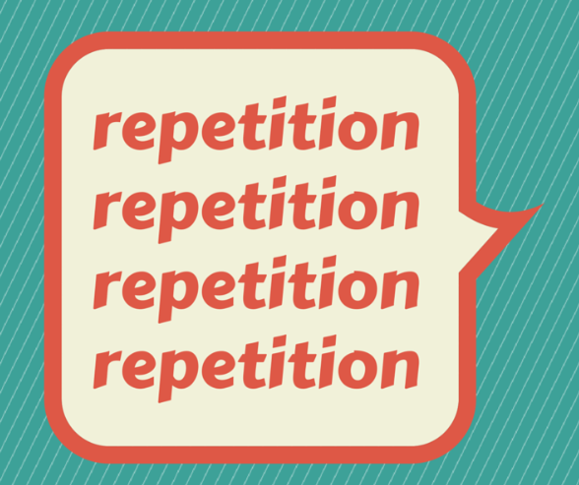
What Automation Tester Does?
Gathers the domain knowledge from either development team or business to write test cases.
Writes the test cases/suits by creating a Test Project for every application.
Test Project Application is tightly bound to the specific application to perform the testing functionalities even for the same actions.

Slide 7


Can we implement it, in a better way?
Automate the “automation” and avoid the repetition.

Slide 8
How?
By developing a product in such a way that, it will read the configuration file and required data and starts the execution “without writing or modifying a single line of code or script”
Smoke Test Application will read the smoke-test.config file written in either json or xml format.

Slide 9
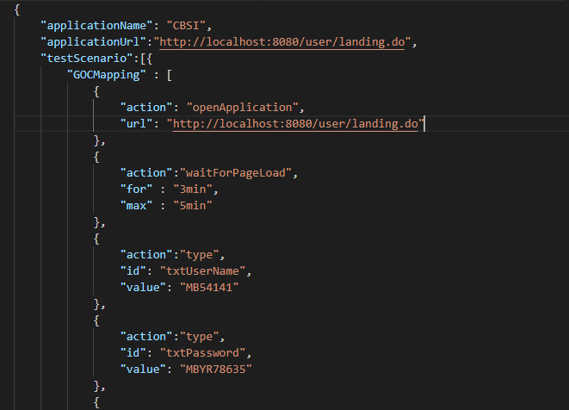
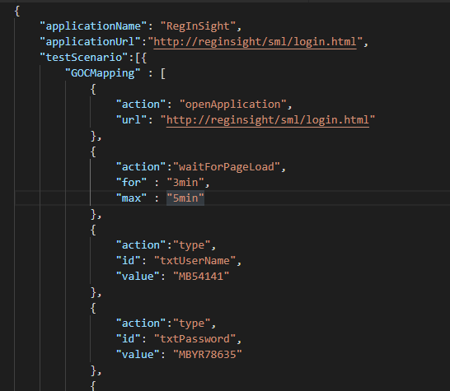
smoke-test.config file
cbsi-smoke-test.config.json
regInSight-smoke-test.config.json

Slide 10
Smoke Test Application
CBSI
Test results
Notify to email distribution list
Smoke Test App Automation Engine
RegInSight
…N number of applications

Slide 11
Benefits Of Smoke Application
Config files or test suits can be written by
a manual tester
automation tester
or a developer.
Plug and play – only .exe or .jar is required to execute the test suit.
Multiple instances on the same machine can be started for testing different scenarios and to test load balancing.

Slide 12
How Xoriant will be benefited?
The same product we can propose to all the clients of Xoriant who has the web application, by changing the logo.
In the worst case, if client does not like it, we can use this internally for testing all the web application.

Slide 13
Want to have a demo again ?
Want to have a demo again?

Slide 14
Questions
Questions, answers or discussion

Slide 15
Why Selenium

Slide 16
Thanks for your time and I appreciate your patience !

